Slide 1
Design Alternatives
CSE 215 (Database)
Ref: Korth (Chapter 7)
Md. Saiful Islam
Lecturer
Department of CSE, BUET

Slide 2
Design Goal
Avoid bad designs
Redundancy
Incompleteness
Choose from a large number of good models
Consider a customer who buys a product. Is the
sale of this product a relationship between the
customer and the product? Alternatively, is the sale
itself an entity that is related both to the customer
and to the product?

Slide 3
Design Goal
Avoid bad designs
Redundancy
Incompleteness
Choose from a large number of good models
Database design requires a combination of
both science and “good taste. ”

Slide 4
Sample Case: University Management System
Each Department has students and instructors, and offers multiple courses.
Each Department has class rooms for each section.
A section is a group of students (same level, term) enrolled in a particular course. For each section, an instructor and class schedule is assigned.

Slide 5
Removing Redundant Attributes
Once the entity sets are decided upon, we must choose the appropriate attributes. These attributes are supposed to represent the various values we want to capture in the database. In the university organization, we decided that for the instructor entity set, we will include the attributes ID, name, dept name, and salary. We could have added the attributes: phone number, office number, home page, etc. The choice of what attributes to include is up to the designer, who has a good understanding of the structure of the enterprise.

Slide 6
Removing Redundant Attributes
The relationship sets may result in a situation where attributes in the various entity sets are redundant and need to be removed from the original entity sets.

Slide 7
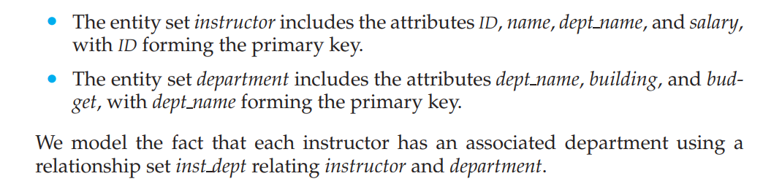
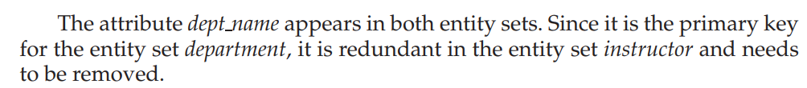
Removing Redundant Attributes
Treating the connection between instructors and departments uniformly as a relationship, rather than as an attribute of instructor, makes the logical relationship explicit, and helps avoid a premature assumption that each instructor is associated with only one department.

Slide 8
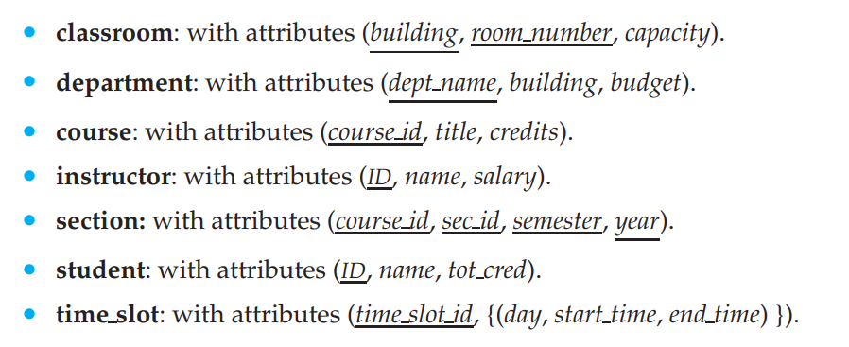
Removing Redundant Attributes

Slide 9
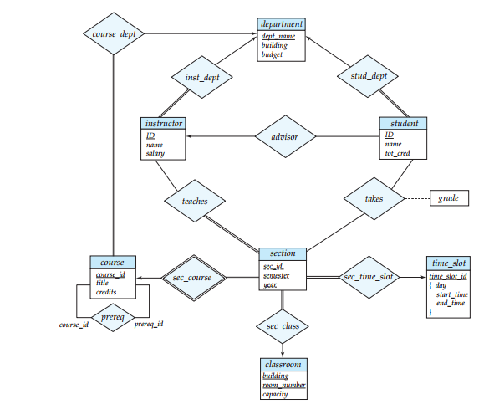
University Management System

Slide 10
ERD Design Issues
Ref: Korth Section 7.7

Slide 11
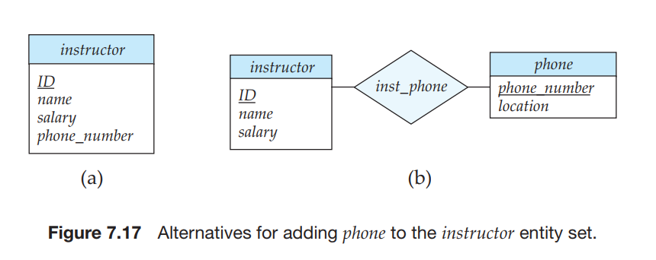
ERD Design Issues Use of Entity Sets versus Attributes
Treating a phone as an entity better models a situation where one may want to keep extra information about a phone, such as its location, or its type (mobile, IP phone, or plain old phone)

Slide 12
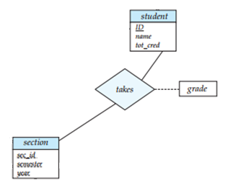
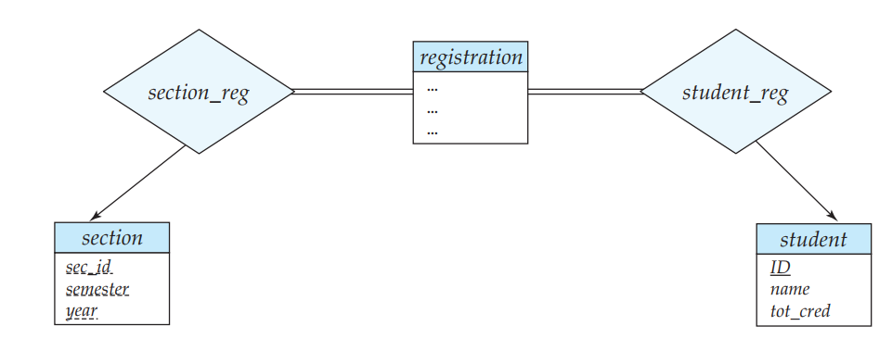
ERD Design Issues Use of Entity Sets versus Relationship Sets
(a)
(b)

Slide 13
ERD Design Issues Use of Entity Sets versus Relationship Sets
Both the approach accurately represent the university’s information, but the use of takes is more compact and probably preferable.
However, if the registrar’s office associates other information with a course-registration record, it might be best to make it an entity in its own right.

Slide 14
ERD Design Issues Binary versus n-ary Relationship Sets
One could create a ternary relationship parent, relating a child to his/her mother and father. However, such a relationship could also be represented by two binary relationships, mother and father, relating a child to his/her mother and father separately.
Using the two relationships mother and father provides us a record of a child’s mother, even if we are not aware of the father’s identity; a null value would be required if the ternary relationship parent is used. Using binary relationship sets is preferable in this case.

Slide 15
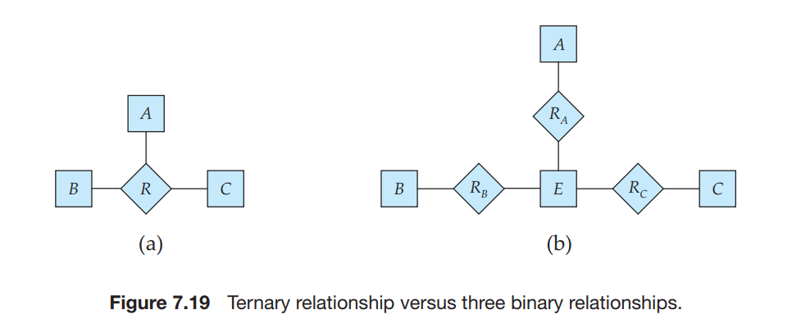
ERD Design Issues Binary versus n-ary Relationship Sets
If the relationship set R had any attributes, these are assigned to entity set E; further, a special identifying attribute is created for E.

Slide 16
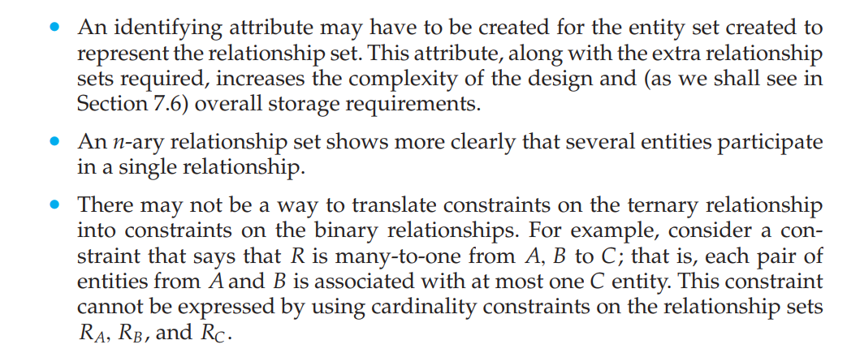
ERD Design Issues Binary versus n-ary Relationship Sets
Why n-ary?

Slide 17
ERD Design Issues Placement of Relationship Attributes
Attributes of one-to-one or one-to-many relationship sets can be associated with one of the participating entity sets, rather than with the relationship set.
let us specify that advisor is a one-to-many relationship set such that one instructor may advise several students, but each student can be advised by only a single instructor.
In this case, the attribute date, which specifies when the instructor became the advisor of a student, could be associated with the student entity set .
The choice of attribute placement is more clear-cut for many-to-many relationship sets.

Slide 18
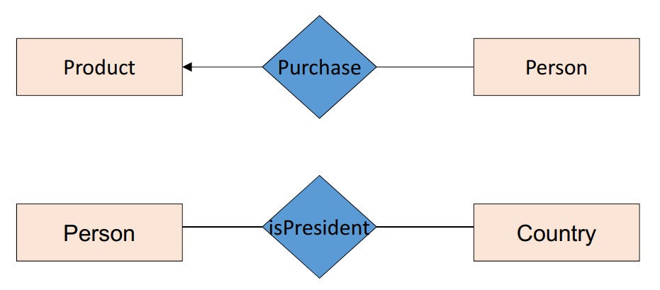
ERD Design Issues What’s Wrong?

Slide 19
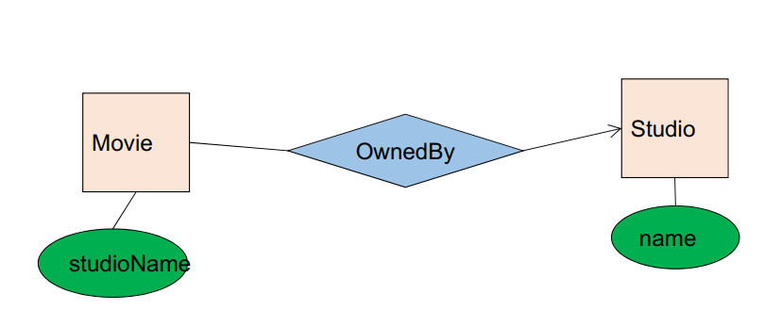
ERD Design Issues What’s Wrong?

Slide 20
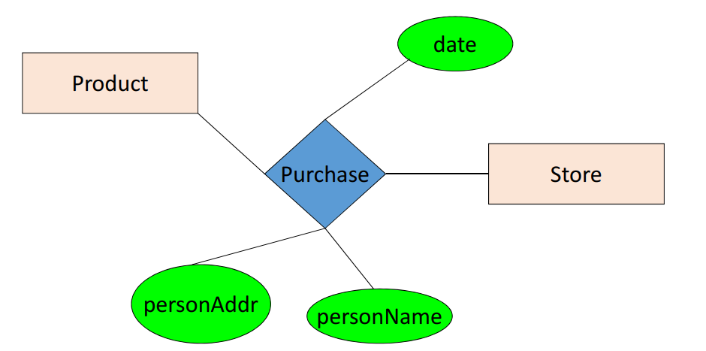
ERD Design Issues What’s Wrong?

Slide 21
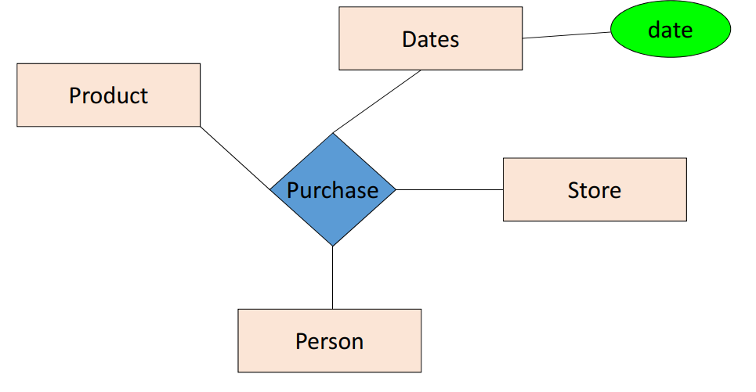
ERD Design Issues What’s Wrong?

Slide 22
Don’t complicate life.
It’s already complicated enough ☺

